Slide 1
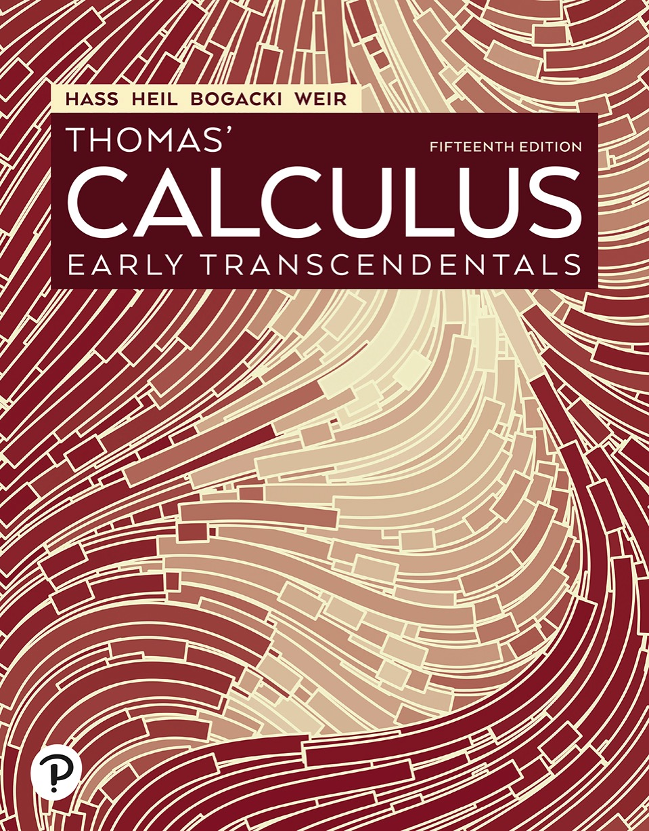

Thomas’ Calculus: Early Transcendentals
Fifteenth Edition
Chapter 16
Integrals and Vector Fields
Copyright © 2023, 2018, 2014 Pearson Education, Inc. All Rights Reserved
Notes:
If this PowerPoint presentation contains mathematical equations, you may need to check that your computer has the following installed:
1) MathType Plugin
2) Math Player (free versions available)
3) NVDA Reader (free versions available)

Slide 2
Section 16.1 Line Integrals of Scalar Functions

Slide 3
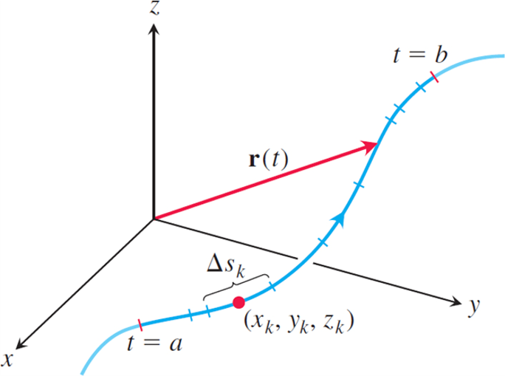
Line Integrals of Scalar Functions (1 of 6)
The curve
partitioned into small arcs from t = a
to t = b. The length of a typical subarc is

Slide 4
Line Integrals of Scalar Functions (2 of 6)
Definition: If f is defined on a curve C given
parametrically by
then the line integral of f over C is
provided this limit exists.

Slide 5
Line Integrals of Scalar Functions (3 of 6)
How to Evaluate a Line Integral
To integrate a continuous function
over a
curve C:
1. Find a smooth parametrization of C,
2. Evaluate the integral as

Slide 6
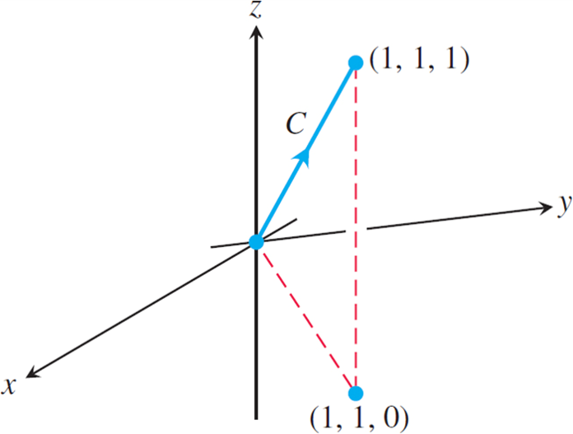
Line Integrals of Scalar Functions (4 of 6)
The integration path in the following Example.

Slide 7
Line Integrals of Scalar Functions (5 of 6)
Example: Integrate
over the
line segment C joining the origin to the point (1, 1, 1).
Solution: Since any choice of parametrization will give the same answer, we choose the simplest parametrization we can think of:

Slide 8
Line Integrals of Scalar Functions (6 of 6)
Solution (concluded):
The components have continuous first derivatives
and
is never 0, so the
parametrization is smooth. The integral of f over C is

Slide 9
Additivity (1 of 8)

Slide 10
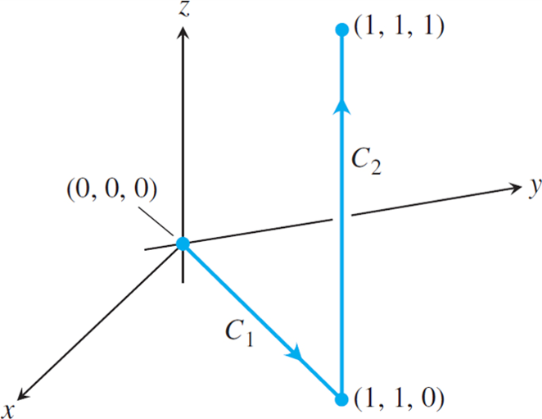
Additivity (2 of 8)
The path of integration in the following Example.

Slide 11
Additivity (3 of 8)
Example: The Figure above shows another path from the origin to (1, 1, 1), formed from two line
segments
Integrate
over
Solution: We choose the simplest parametrizations
for
we can find, calculating the lengths
of the velocity vectors as we go along:

Slide 12
Additivity (4 of 8)
Solution (concluded):
With these parametrizations we find that

Slide 13
Additivity (5 of 8)
The value of the line integral along a path joining two points can change if you change the path between them.

Slide 14
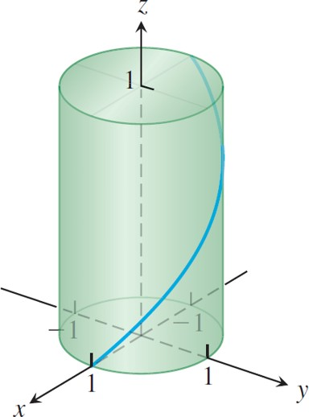
Additivity (6 of 8)
A line integral is taken over a curve such as this helix.

Slide 15
Additivity (7 of 8)
Example: Find the line integral of
over the helix
Solution: For the helix we find
and
Evaluating the
function f at the point
we obtain

Slide 16
Additivity (8 of 8)
Solution (concluded):
The line integral is given by

Slide 17
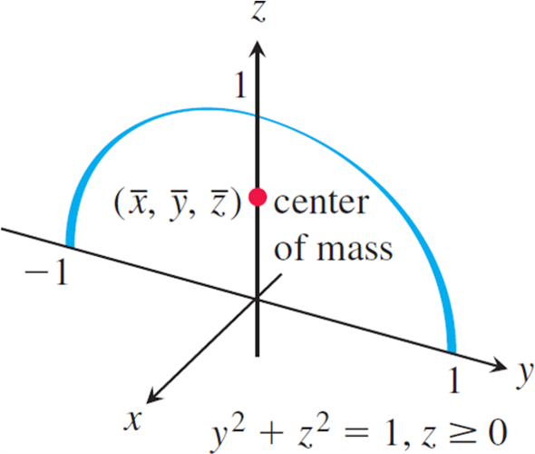
Mass and Moment Calculations (1 of 5)
The Example shows how to find the center of mass of a circular arch of variable density.

Slide 18
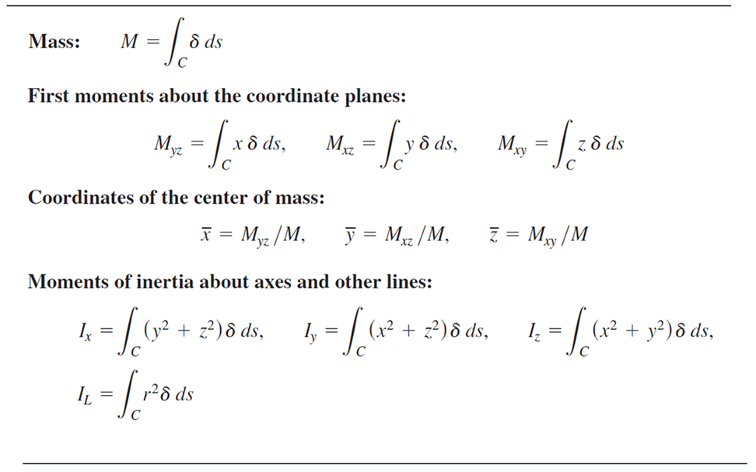
Mass and Moment Calculations (2 of 5)
Table Mass and moment formulas for coil springs, wires, and thin rods lying along a smooth curve C in space
Notes:
The formulas are as follows. Mass M = the integral of delta d s, for curve C. Delta = delta of x, y, and z is the density at (x, y, z). First moments about the coordinate planes. M sub start expression y z end expression = the integral of x delta d s, for curve C. M sub start expression x z end expression = the integral of y delta d s, for curve C. M sub start expression x y end expression = the integral of z delta d s, for curve C. Coordinates of the center of mass. x bar = start fraction M sub start expression y z end expression over M end fraction. y bar = start fraction M sub start expression x z end expression over M end fraction. z bar = start fraction M sub start expression x y end expression over M end fraction. Moments of inertia about axes and other lines are as follows. I sub x = the integral of left parenthesis y squared + z squared right parenthesis delta d s, for curve C. I sub y = the integral of left parenthesis x squared + z squared right parenthesis delta d s, for curve C. I sub z = the integral of left parenthesis x squared + y squared right parenthesis delta d s, for curve C. I sub L = the integral of r squared delta d s, for curve C. r of x, y, and z = distance from (x, y, z) to line L.

Slide 19
Mass and Moment Calculations (3 of 5)
Example: A slender metal arch, denser at the bottom
than top, lies along the semicircle
in the y z-plane. Find the center of the arch’s mass if the
density at the point (x, y, z) on the arch is
Solution: We know that
because the
arch lies in the y z-plane with its mass distributed
symmetrically about the z-axis. To find
we
parametrize the circle as

Slide 20
Mass and Moment Calculations (4 of 5)
Solution (continued):
For this parametrization,
so
The formulas in the Table above then give

Slide 21
Mass and Moment Calculations (5 of 5)
Solution (concluded):
With
to the nearest hundredth, the center of mass
is (0, 0, 0.57).

Slide 22
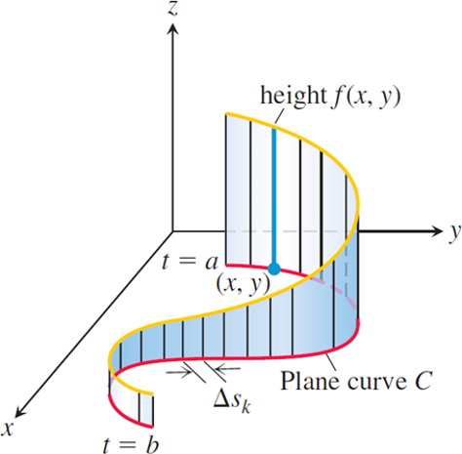
Line Integrals in the Plane
The line integral
gives the area of the portion
of the cylindrical surface or “wall” beneath
Notes:
The plane curve C is a sinusoidal curve. The plane curve extends from t = a to t = b. Several vertical lines are drawn along the curve C, perpendicular to the x y plane, and parallel to the z axis. Delta s sub k is the distance between each vertical line. The height of such vertical lines increases gradually from t = b to t = a. The vertical line from point (x, y) is labeled, height f of (x, y).

Slide 23
Section 16.2 Vector Fields and Line Integrals: Work, Circulation, and Flux

Slide 24
Vector Fields (1 of 3)
A vector field is a function that assigns a vector to each point in its domain. A vector field on a three-dimensional domain in space might have a formula like
The vector field is continuous if the component functions M, N, and P are continuous; it is differentiable if each of the component functions is differentiable. The formula for a field of two-dimensional vectors could look like

Slide 25
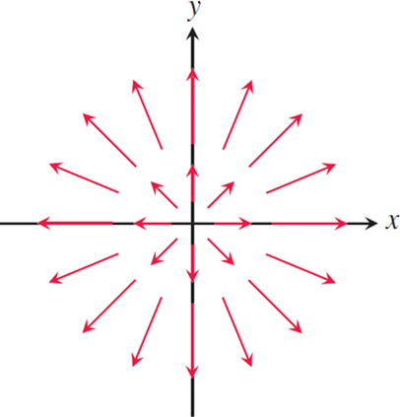
Vector Fields (2 of 3)
The radial field
formed by the position
vectors of points in the plane. Notice the convention that an arrow is drawn with its tail, not its head, at the point where F is evaluated.

Slide 26
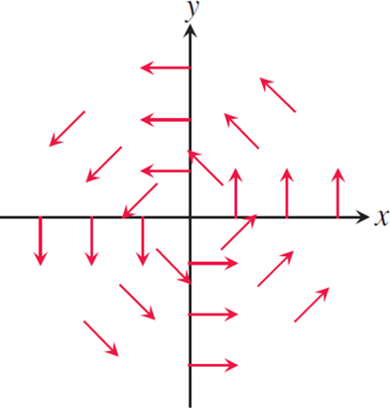
Vector Fields (3 of 3)
A “spin” field of rotating unit vectors
in the plane. The field is not defined at the origin.

Slide 27
Gradient Fields (1 of 3)
The gradient field of a differentiable function
to be the field of gradient vectors

Slide 28
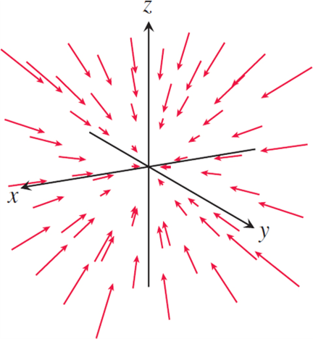
Gradient Fields (2 of 3)
The vectors in a temperature gradient field point in the direction of greatest increase in temperature. In this case they are pointing toward the origin.

Slide 29
Gradient Fields (3 of 3)
Example: Suppose that a material is heated, that the resulting temperature T at each point (x, y, z) in a region of space is given by
and that
is defined to be the gradient of T.
Find the vector field F.
Solution: The gradient field F is the field
At each point in the region,
the vector field F gives the direction for which the increase in temperature is greatest.

Slide 30
Line Integrals of Vector Fields (1 of 5)
Definition: Let F be a vector field with continuous components defined along a smooth curve C
parametrized by
Then the line
integral of F along C is

Slide 31
Line Integrals of Vector Fields (2 of 5)
Evaluating the Line Integral of
Along C:
1. Express the vector field F along the parametrized curve C as
by substituting the components
of r into the scalar components
of F.
2. Find the derivative (velocity) vector
3. Evaluate the line integral with respect to the parameter t, a
≤ t ≤ b, to obtain

Slide 32
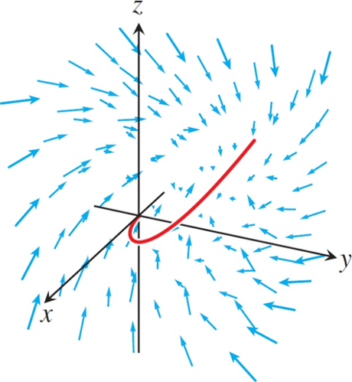
Line Integrals of Vector Fields (3 of 5)
The curve (in red) winds through the vector field. The line integral is determined by the vectors that lie along the curve.

Slide 33
Line Integrals of Vector Fields (4 of 5)
Example:
Evaluate
where
along the curve C given by
Solution: We have
and

Slide 34
Line Integrals of Vector Fields (5 of 5)
Solution (concluded):
Thus,

Slide 35
Line Integrals with Respect to d x, d y, or d z (1 of 2)

Slide 36
Line Integrals with Respect to d x, d y, or d z (2 of 2)
Example: Evaluate the line integral
where C is the helix
Solution: We express everything in terms of the parameter
t, so
Then,

Slide 37
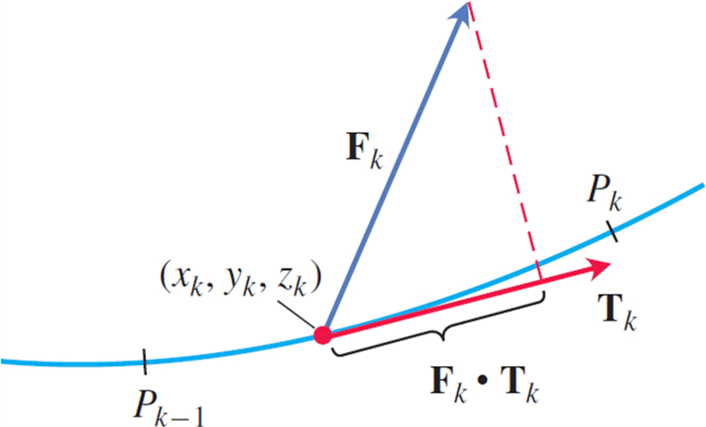
Work Done by a Force over a Curve in Space (1 of 7)
The work done along the subarc shown here is
approximately
and

Slide 38
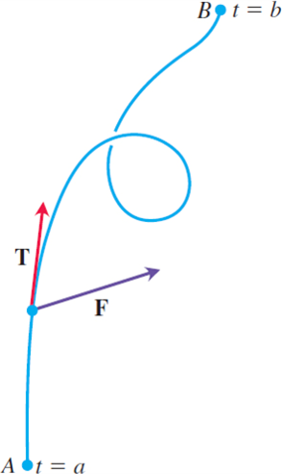
Work Done by a Force over a Curve in Space (2 of 7)
The work done by a force F is the line integral of the
scalar component
over the smooth curve from
A to B.

Slide 39
Work Done by a Force over a Curve in Space (3 of 7)
Definition: Let C be a smooth curve parametrized by
and let F be a continuous force field
over a region containing C. Then the work done in
moving an object from the point
to the point
along C is

Slide 40
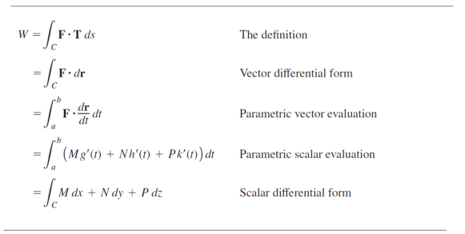
Work Done by a Force over a Curve in Space (4 of 7)
Table Different ways to write the work integral for
over the curve C:
Notes:
The columns have the following headings from left to right. Work integral, Type. The row entries are as follows. Row 1. W = the integral of start expression F times T d s end expression, for curve C, The definition. Row 2. = the integral of start expression f times d r end expression, for curve C, Vector differential form. Row 3. = the integral of start expression F times derivative of r with respect to t d t end expression, from a to b, Parametric vector evaluation. Row 4. = the integral of left parenthesis M g prime of t + N h prime of t + P k prime of t right parenthesis d t, from a to b, Parametric scalar evaluation. Row 5. = the integral of start expression M d x + N d y + P d z end expression, for curve C, Scalar differential form.

Slide 41
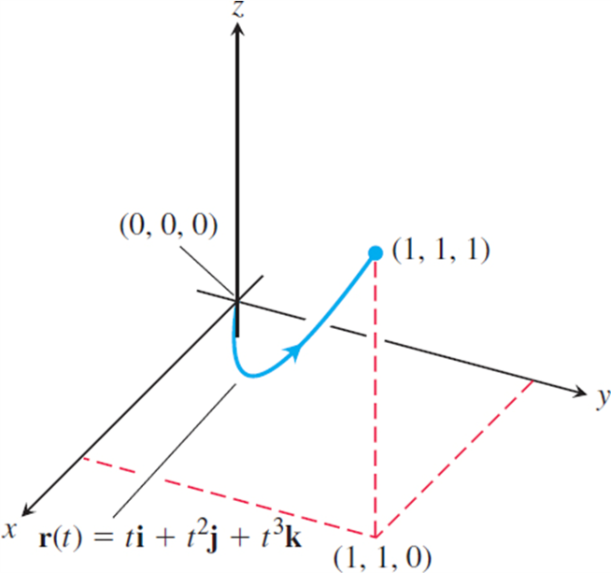
Work Done by a Force over a Curve in Space (5 of 7)
The curve in the next Example.

Slide 42
Work Done by a Force over a Curve in Space (6 of 7)
Example: Find the work done by the force field
in moving an object along
the curve
from
(0, 0, 0) to (1, 1, 1).
Solution: First we evaluate F on the curve
Then we find

Slide 43
Work Done by a Force over a Curve in Space (7 of 7)
Solution (concluded):
Finally, we find
and integrate from t = 0 to t = 1:
So,

Slide 44
Flow Integrals and Circulation for Velocity Fields (1 of 6)
Definition: If
parametrizes a smooth curve C
in the domain of a continuous velocity field F, the
flow along the curve from
The integral is called a flow integral. If the curve starts and ends at the same point, so that A = B, the flow is called the circulation around the curve.

Slide 45
Flow Integrals and Circulation for Velocity Fields (2 of 6)
Example: A fluid’s velocity field is
Find the flow along the helix
Solution: We evaluate F on the curve
and then find
The dot product of F with

Slide 46
Flow Integrals and Circulation for Velocity Fields (3 of 6)
Solution (concluded):
Finally, we integrate

Slide 47
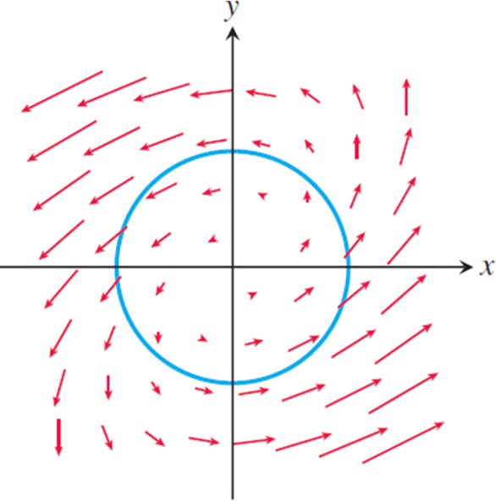
Flow Integrals and Circulation for Velocity Fields (4 of 6)
The vector field F and curve

Slide 48
Flow Integrals and Circulation for Velocity Fields (5 of 6)
Example: Find the circulation of the field
around the circle
Solution: On the circle,
Then

Slide 49
Flow Integrals and Circulation for Velocity Fields (6 of 6)
Solution (concluded):
gives
A fluid with this velocity field is circulating counterclockwise around the circle, so the circulation is positive.

Slide 50
Flux Across a Simple Closed Plane Curve (1 of 5)
Definition: If C is a smooth simple closed curve in
the domain of a continuous vector field
in the plane, and if n is the
outward-pointing unit normal vector on C, the flux of F across C is

Slide 51
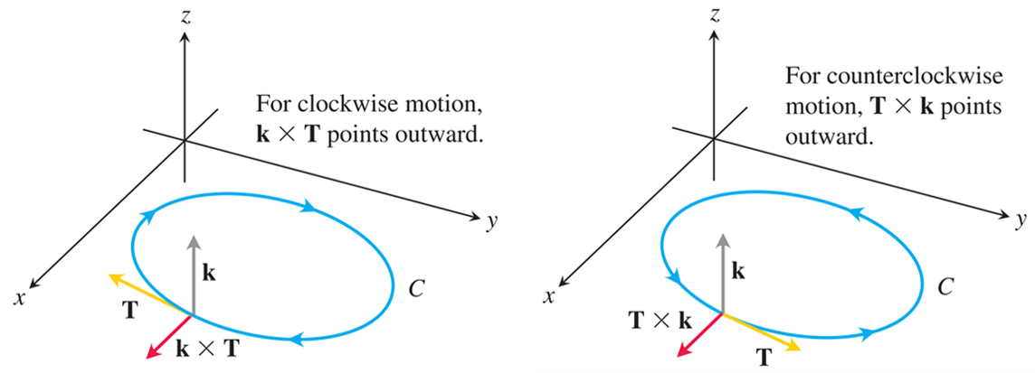
Flux Across a Simple Closed Plane Curve (2 of 5)
To find an outward unit normal vector for a smooth simple curve C in the x y-plane that is traversed
counterclockwise as t increases, we take
For clockwise motion, we take
Notes:
The first graph shows a circle C in the x y plane. The path of the circle is in a clockwise direction. Three vectors emerge from a point in the circle. Vector k runs parallel to the z axis, vector T runs to the left, parallel to the y axis, and is tangential to C, vector k times t runs parallel to the x axis. The second graph shows a circle C in the x y plane. The path of the circle is in a counterclockwise direction. Three vectors emerge from a point. Vector k runs parallel to the z axis, vector T runs to the right, parallel to the y axis, and is tangential to C, vector T times k runs parallel to the x axis.

Slide 52
Flux Across a Simple Closed Plane Curve (3 of 5)
Calculating Flux Across a Smooth Closed Plane Curve
The integral can be evaluated from any smooth
parametrization
that traces C counterclockwise exactly once.

Slide 53
Flux Across a Simple Closed Plane Curve (4 of 5)
Example: Find the flux of
across the
circle
in the x y-plane.
Solution: The parametrization
traces the circle counterclockwise exactly
once. We can therefore use this parametrization with

Slide 54
Flux Across a Simple Closed Plane Curve (5 of 5)
Solution (concluded):
We find
The flux of F across the circle is π. Since the answer is positive, the net flow across the curve is outward. A net inward flow would have given a negative flux.

Slide 55
Section 16.3 Path Independence, Conservative Fields, and Potential Functions

Slide 56
Path Independence (1 of 2)
Definitions: Let F be a vector field defined on an open region D in space, and suppose that for any two points A and B in D the line integral
along a path C from A to B in D is the same
over all paths from A to B. Then the integral
is path independent in D and the field F
is conservative on D.

Slide 57
Path Independence (2 of 2)
Definition: If F is a vector field defined on D and
for some scalar function f on D, then f is
called a potential function for F.

Slide 58
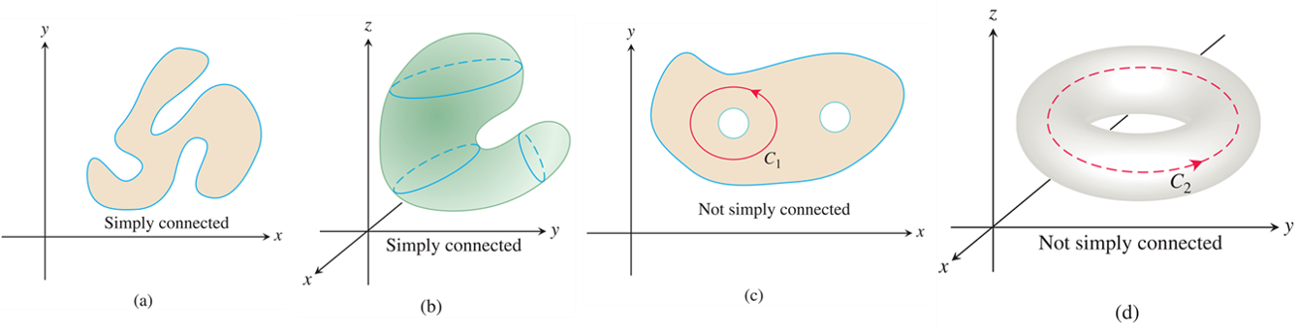
Assumptions on Curves, Vector Fields, and Domains
Four connected regions. In (a) and (b), the regions are simply connected. In (c) and (d), the regions are not
simply connected because the curves
cannot be contracted to a point inside the regions containing them.
Notes:
Graph a plots an irregular closed figure in an x y plane. This shape is simply connected. Graph b plots a shape in an x y z plane. The shape resembles a tilted U. This shape is simply connected. Graph c plots an irregular shape with two circular holes in it. A circular path is traced around one of the holes and labeled, C sub 1. This path runs counterclockwise. This shape is not simply connected. Graph d plots a resemble an annulus, in an x y z plane. The path of the tube runs counterclockwise and is labeled, C sub 2. This shape is not simply connected.

Slide 59
Line Integrals in Conservative Fields (1 of 5)
Theorem—Fundamental Theorem of Line Integrals
Let C be a smooth curve joining the point A to the point B in the plane or in space and parametrized by
Let f be a differentiable function with a continuous gradient vector
on a domain D containing C. Then

Slide 60
Line Integrals in Conservative Fields (2 of 5)
Example: Suppose the force field
is the gradient
of the function
Find the work done by F in moving an object along a smooth curve C joining (1, 0, 0) to (0, 0, 2) that does not pass through the origin.
Solution: An application of the Theorem shows that the work done by F along any smooth curve C joining the two points and not passing through the origin is

Slide 61
Line Integrals in Conservative Fields (3 of 5)
Theorem—Conservative Fields are Gradient Fields
Let F = M i + N j + P k be a vector field whose components are continuous throughout an open connected region D in space. Then F is conservative
if and only if F is a gradient field
for a differentiable
function f.

Slide 62
Line Integrals in Conservative Fields (4 of 5)
Example: Find the work done by the conservative field
in moving an object along any smooth curve C joining
the point
Solution: With
we have

Slide 63
Line Integrals in Conservative Fields (5 of 5)
Theorem—Loop Property of Conservative Fields
The following statements are equivalent.
1.
around every loop (that is, closed
curve C ) in D.
2. The field F is conservative on D.

Slide 64
Finding Potentials for Conservative Fields (1 of 6)
Component Test for Conservative Fields
Let
be a
field on an open simply connected domain whose component functions have continuous first partial derivatives. Then, F is conservative if and only if

Slide 65
Finding Potentials for Conservative Fields (2 of 6)
Example: Show that
is conservative over its natural domain and find a potential function for it.
Solution: The natural domain of F is all of space, which is open and simply connected. We apply the test to
and calculate

Slide 66
Finding Potentials for Conservative Fields (3 of 6)
Solution (continued):
The partial derivatives are continuous, so these equalities tell us that F is conservative, so there is a
function f with
We find f by integrating the equations
We integrate the first equation with respect to x, holding y and z fixed, to get

Slide 67
Finding Potentials for Conservative Fields (4 of 6)
Solution (continued):
We write the constant of integration as a function of y and z because its value may depend on y and z, though not on x.
So
Therefore, g is a function of z alone, and
We now calculate
from this equation and match it
to the formula for
This gives

Slide 68
Finding Potentials for Conservative Fields (5 of 6)
Solution (concluded):
so
Hence,
We found infinitely many potential functions of F, one for each value of C.

Slide 69
Finding Potentials for Conservative Fields (6 of 6)
Example: Show that
is
not conservative.
Solution: We apply the Component Test and find immediately that
The two are unequal, so F is not conservative. No further testing is required.

Slide 70
Exact Differential Forms (1 of 5)
Definitions: Any expression
is a differential form. A differential
form is exact on a domain D in space if
for some scalar function f throughout D.

Slide 71
Exact Differential Forms (2 of 5)
Component Test for Exactness of
The differential form
is exact
on an open simply connected domain if and only if
This is equivalent to saying that the field
is conservative.

Slide 72
Exact Differential Forms (3 of 5)
Example: Show that y d x + x d y + 4 d z is exact and evaluate the integral
over any path from (1, 1, 1) to
Solution: We let M = y, N = x, P = 4 and apply the Test for Exactness:
These equalities tell us that y d x + x d y + 4 d z is exact, so

Slide 73
Exact Differential Forms (4 of 5)
Solution (continued):
for some function f, and the integral’s value is
We find f up to a constant by integrating the equations
From the first equation we get
The second equation tells us that

Slide 74
Exact Differential Forms (5 of 5)
Solution (concluded):
Hence, g is a function of z alone, and
The third Equation tells us that
Therefore,
The value of the line integral is independent of the path
taken from (1, 1, 1) to
and equals

Slide 75
Section 16.4 Green’s Theorem in the Plane

Slide 76
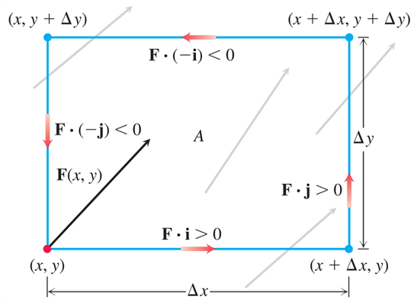
Spin Around an Axis: The k-Component of Curl (1 of 9)
The rate at which a fluid flows along the bottom edge of a rectangular region A in the direction i is approximately
which is positive for
the vector field F shown here. To approximate the rate of circulation at the point (x, y), we calculate the (approximate) flow rates along each edge in the directions of the red arrows, sum these rates, and then divide the sum by the area of A. Taking the limit as
gives the rate of the
circulation per unit area.
Notes:
The length of the rectangle is marked, delta x, and the breadth is marked, delta y. The vertices of the rectangle are as follows. (x, y), (x, y + delta y), (x + delta x, y + delta y), and (x + delta x, y). The vector running along the bottom is labeled, F times i is greater than 0. The vector running along the right side is labeled, F times j is greater than 0. The vector running along the top is labeled, F times negative i is less than 0. The vector running along the left side is labeled, F times negative j is less than 0. The vectors in the rectangle represent the circulation rate. A vector with an increasing slope starts from (x, y), in the left bottom corner. This vector is labeled, F (x, y).

Slide 77
Spin Around an Axis: The k-Component of Curl (2 of 9)
Definition: The circulation density of a vector field F = M i + N j at the point (x, y) is the scalar expression
This expression is also called the k-component of
the curl, denoted by

Slide 78
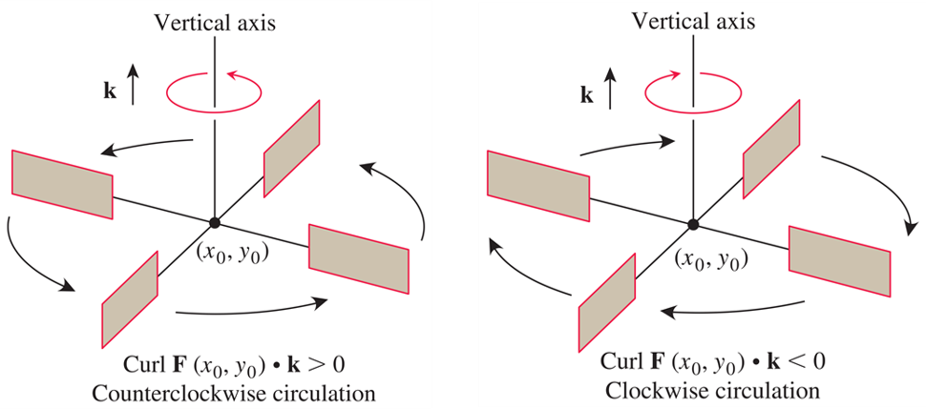
Spin Around an Axis: The k-Component of Curl (3 of 9)
In the flow of an incompressible fluid over a plane region, the k-component of the curl measures the rate of the fluid’s rotation at a point. The k-component of the curl is positive at points where the rotation is counterclockwise and negative where the rotation is clockwise.
Notes:
The first illustration has a paddle wheel spinning in a counterclockwise direction, around a vertical axis. The central point of the paddle wheel, where the paddles are joined, is labeled, (x sub zero, y sub zero). An upward arrow is labeled, k, where k is greater than 0. The second illustration has a paddle wheel spinning in a clockwise direction, around a vertical axis. The central point of the paddle wheel, where the paddles are joined, is labeled, (x sub zero, y sub zero). An upward arrow is labeled, k, where k is less than 0.

Slide 79
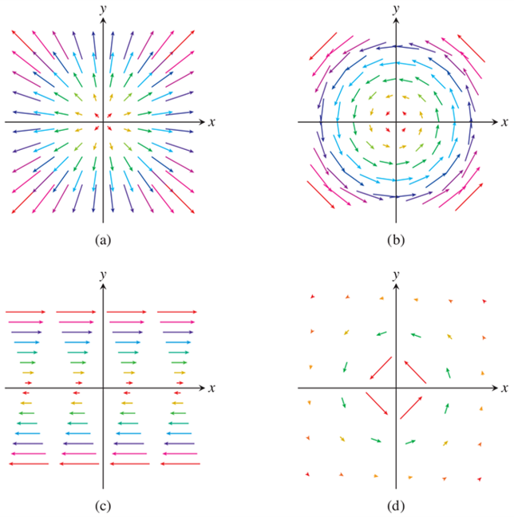
Spin Around an Axis: The k-Component of Curl (4 of 9)
Velocity fields of a gas flowing in the plane.
Notes:
The graphs are as follows. Graph a represents uniform expansion or compression. The vectors move away from the origin. The vectors above the x axis have an increasing slope, and the vectors below the x axis have a decreasing slope. The vectors increase in length as they move away from the origin. Graph b represents uniform rotation. The vectors move counterclockwise and make concentric circular formations around the origin. The length of the vectors increases as their distance from the origin increases. Graph c represents shearing flow. Above the x axis the vectors flow from left to right with zero slope, in formations resembling inverted triangles. Below the x axis, the vectors move from right to left with zero slope, in formations resembling triangles. The length of the vectors increases with increase in their distance from the x axis. Graph d represents the whirlpool effect. Vectors move around the origin in counterclockwise direction, in concentric circles. In this graph, the gap between the circles is wider than the gap found between the circles in graph b. The length of the vectors decreases as they move away from the origin.

Slide 80
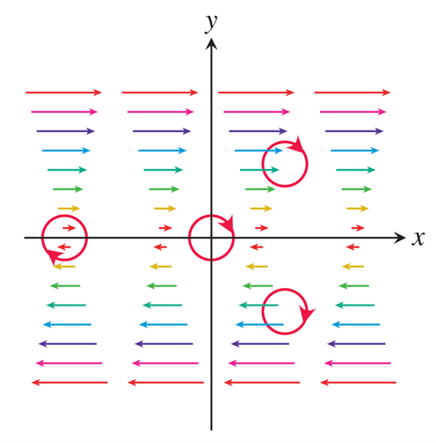
Spin Around an Axis: The k-Component of Curl (5 of 9)
A shearing flow pushes the fluid clockwise around each point.
Notes:
Above the x axis the vectors flow from left to right with zero slope, in formations resembling inverted triangles. Below the x axis, the vectors move from right to left with zero slope, in formations resembling triangles. The length of the vectors increases with increase in their distance from the x axis. The origin is highlighted. A vector above the x axis, flowing from left to right, and a vector below the x axis, flowing from right to left, are highlighted. Two vectors flowing to the right and to the left are highlighted. Two vectors moving in opposite directions along the x axis is also highlighted.

Slide 81
Spin Around an Axis: The k-Component of Curl (6 of 9)
Example: The following vector fields represent the velocity of a gas flowing in the x y-plane. Find the circulation density of each vector field and interpret its physical meaning.
(a) Uniform expansion or compression:
(b) Uniform rotation:
(c) Shearing flow:
(d) Whirlpool effect:

Slide 82
Spin Around an Axis: The k-Component of Curl (7 of 9)
Solution:
(a) Uniform expansion:
The gas is not circulating at very small scales.
(b) Rotation:
The constant circulation density indicates rotation around every point. If c > 0, the rotation is counterclockwise; if c < 0, the rotation is clockwise.

Slide 83
Spin Around an Axis: The k-Component of Curl (8 of 9)
Solution (continued):
(c) Shear:
The circulation
density is constant and negative, so a paddle wheel floating in water undergoing such a shearing flow spins clockwise. The rate of rotation is the same at each point. The average rotational effect of the fluid flow is to push fluid clockwise around each of the small circles.

Slide 84
Spin Around an Axis: The k-Component of Curl (9 of 9)
Solution (concluded):
(d) Whirlpool:
The circulation density is 0 at every point away from the origin (where the vector field is undefined and the whirlpool effect is taking place), and the gas is not circulating at any point for which the vector field is defined.

Slide 85
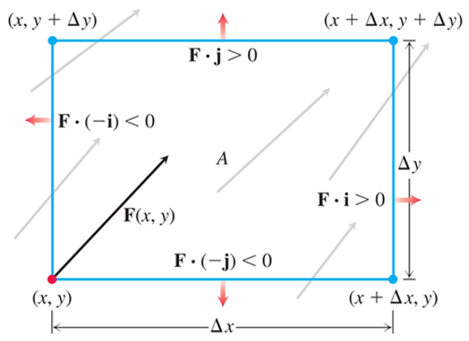
Divergence (1 of 5)
The rate at which the fluid leaves the rectangular region A across the bottom edge in the direction of the outward normal
which is negative
for the vector field F shown here. To approximate the flow rate at the point (x, y), we calculate the (approximate) flow rates across each edge in the directions of the red arrows, sum these rates, and then divide the sum by the area of A. Taking the limit as
gives the flow
per unit area.
Notes:
The length of the rectangle is marked, delta x, and the breadth is marked, delta y. The vertices of the rectangle are as follows. (x, y), (x, y + delta y), (x + delta x, y + delta y), and (x + delta x, y). The vector from the bottom of the rectangle is labeled, F times negative j is less than 0. The vector from the right side is labeled, F times i is greater than 0. The vector running from the top is labeled, F times j is greater than 0. The vector running from the left side is labeled, F times negative i is less than 0. The vectors in the rectangle represent the flow of the fluid. A vector with an increasing slope starts from (x, y), in the left bottom corner. This vector is labeled, F (x, y).

Slide 86
Divergence (2 of 5)
Definition: The divergence (flux density) of a vector field F = M i + N j at the point (x, y) is

Slide 87
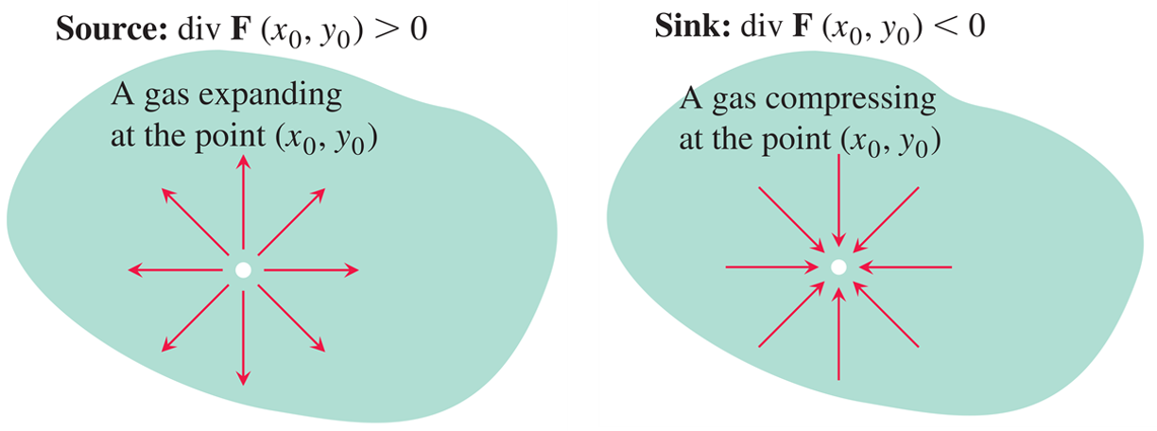
Divergence (3 of 5)
If a gas is expanding at a point
the lines of
flow have positive divergence; if the gas is compressing, the divergence is negative.
Notes:
The first direction field represents a gas expanding at a point. The vectors point away from (x sub zero, y sub zero). The second direction field represents a gas compressing at the point. Vectors from various directions point to (x sub zero, y sub zero).

Slide 88
Divergence (4 of 5)
Example: Find the divergence, and interpret what it means, for each vector field in the prior Example representing the velocity of a gas flowing in the x y-plane.
Solution:
(a)
If c > 0, the gas is
undergoing uniform expansion; if c < 0, it is undergoing uniform compression.

Slide 89
Divergence (5 of 5)
Solution (concluded):
(b)
The gas is neither
expanding nor compressing.
(c)
The gas is neither expanding nor
compressing.
(d)
Again, the divergence is zero at all points in the domain of the velocity field.

Slide 90
Two Forms for Green’s Theorem (1 of 7)
Theorem—Green’s Theorem (Circulation-Curl or Tangential Form)
Let C be a piecewise smooth, simple closed curve enclosing a region R in the plane. Let F = M i + N j be a vector field with M and N having continuous first partial derivatives in an open region containing R. Then the counterclockwise circulation of F around C equals the
double integral of
over R.

Slide 91
Two Forms for Green’s Theorem (2 of 7)
Theorem—Green’s Theorem (Flux-Divergence or Normal Form)
Let C be a piecewise smooth, simple closed curve enclosing a region R in the plane. Let F = M i + N j be a vector field with M and N having continuous first partial derivatives in an open region containing R. Then the outward flux of F across C equals the double integral of div F over the region R enclosed by C.

Slide 92
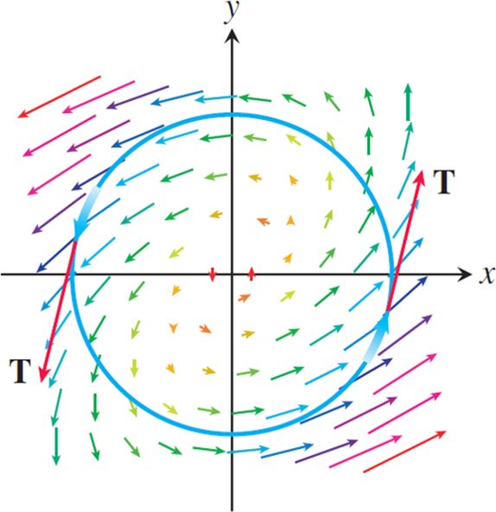
Two Forms for Green’s Theorem (3 of 7)
The vector field has a counterclockwise circulation of
around the unit circle.

Slide 93
Two Forms for Green’s Theorem (4 of 7)
Example: Verify both forms of Green’s Theorem for the vector field
and the region R bounded by the unit circle
Solution: First we evaluate the counterclockwise circulation of F = M i + N j around C. On the curve C we have
Evaluating
and computing
the partial derivatives of the components of F, we have

Slide 94
Two Forms for Green’s Theorem (5 of 7)
Solution (continued):
Therefore,

Slide 95
Two Forms for Green’s Theorem (6 of 7)
Solution (continued):
Next we find the curl. Since
we have
Therefore,

Slide 96
Two Forms for Green’s Theorem (7 of 7)
Solution (concluded):
Now we compute the two sides of the flux-divergence form of Green’s Theorem, starting with the outward flux:
Next we compute the divergence integral:

Slide 97
Using Green’s Theorem to Evaluate Line Integrals (1 of 2)
Example: Evaluate the line integral
where C is the square cut from the first quadrant by the lines x = 1 and y = 1.
Solution: We can use either form of Green’s Theorem to change the line integral into a double integral over the square, where C is the square’s boundary and R is its interior.

Slide 98
Using Green’s Theorem to Evaluate Line Integrals (2 of 2)
Solution (concluded):
1. With the Tangential Form: Taking
and N = x y
gives the result:
2. With the Normal Form: Taking
gives the same result:

Slide 99

Copyright
This work is protected by United States copyright laws and is provided solely for the use of instructors in teaching their courses and assessing student learning. Dissemination or sale of any part of this work (including on the World Wide Web) will destroy the integrity of the work and is not permitted. The work and materials from it should never be made available to students except by instructors using the accompanying text in their classes. All recipients of this work are expected to abide by these restrictions and to honor the intended pedagogical purposes and the needs of other instructors who rely on these materials.

